Slide 1

PROJECT MANAGEMENT

Slide 2




WhatsApp Chat Analytics
Beyond Words: Unlocking Emotional Intelligence
Discover the hidden power of WhatsApp conversations and turn them into customer-centric marketing gold.
Win More Hearts
& Leads
Spark Deeper Customer Connections
Close Deals
Confidence
Boost Brand
Reputation
Notes:
The WhatsApp Chat Analytics Project aims to address the growing demand for an analytics solution that empowers businesses and individuals to gain valuable insights from their WhatsApp conversations. This tool will provide users with the ability to analyze chat data, improve communication strategies, enhance customer experiences, and make data-driven decisions.

Slide 3
Project Objective
Develop a user-friendly Web Based WhatsApp Chat Analytics Tool that allows users to connect their WhatsApp accounts and analyze chat data using latest data analytics features.
Seamless Integration: Securely connect existing WhatsApp accounts.
Powerful Analytics Dashboard: Visualize key trends and insights.
Tone Analysis: Understand the emotional undertones of text and uncover customer satisfaction levels.

Slide 4

Project Management Approach
Waterfall – Agile Hybrid Approach
Define
Initial Planning and Requirements Gathering:
Utilize the waterfall methodology to define the project scope, objectives, and initial requirements.
Iterative Development and User Feedback:
Employ an agile approach for the development phase, incorporating continuous user feedback through iterative sprints and testing cycles.
Documentation and Project Management:
Utilize waterfall-style documentation practices to capture project decisions, user feedback, and evolving requirements.
Plan
Test
Develop
Deploy
Close

Slide 5
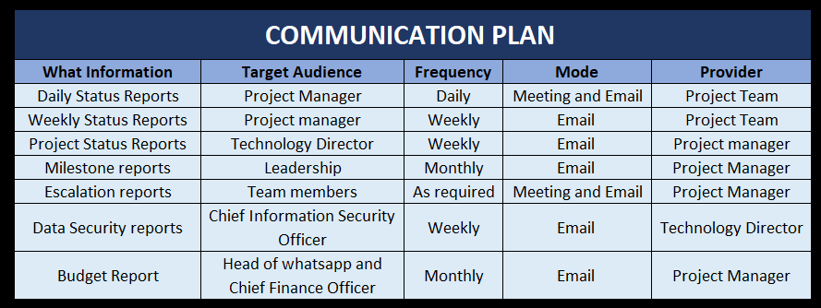
Project Team & Key Stakeholders
Project Team:
Project Manager,
UI/UX Designer
Backend Developer
Data Analyst
Data Engineer
Data Scientist
Quality Assurance Tester
Information Security Analyst
Key Stakeholders:
Head of WhatsApp
Technology Director
Chief Information Security Officer
Chief Finance Officer

Slide 6
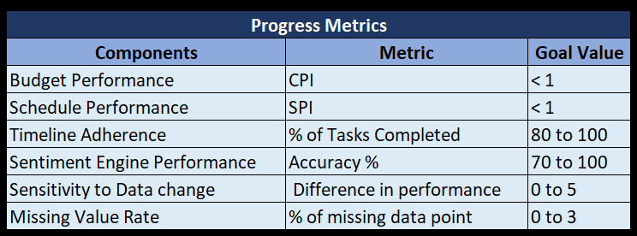
Milestones & Key Deliverables
Milestones:
Define: 09/26/2023
Plan: 09/29/2023
Develop & Test: 01/19/2024
Deploy: 01/26/2024
Close: 01/31/2024
Key Deliverables:
User authentication feature
Data visualization dashboards and reports
Sentiment analysis engine
Keyword and FAQ identification feature
Chat metrics and customization options
User documentation and guides
Project Documentation
Completion Report

Slide 7
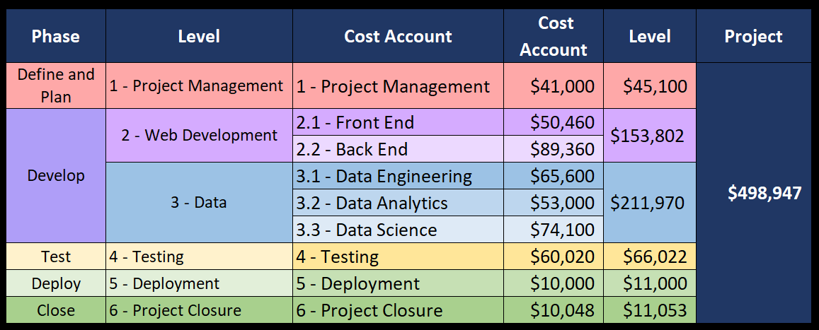
Budget Breakdown

Slide 8
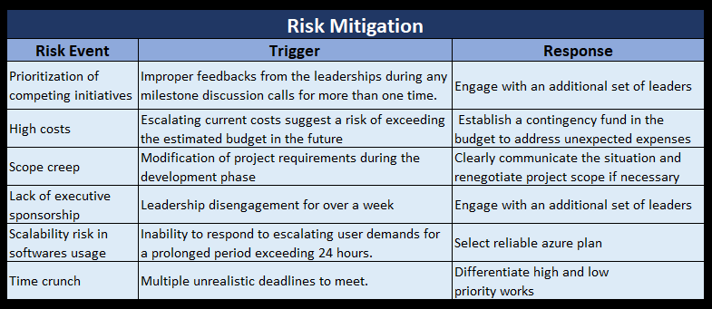
Risk Mitigation Plan

Slide 9
Conclusion
We've embarked on a journey to develop the WhatsApp Chat Analytics Tool, a transformative solution for extracting insights from WhatsApp conversations. Each deliverable contributes to the goal of empowering users with actionable insights.
Our hybrid project management approach blends Waterfall and Agile methodologies, offering a balance of structure and adaptability.
Stakeholder communication is at the forefront, ensuring continuous collaboration and alignment with project goals.
Proactive risk management, including a risk assessment matrix and mitigation controls, reinforces our commitment to project success.
WhatsApp Chat Analytics Tool is a strategic initiative to redefine how we understand and leverage our WhatsApp conversations. We appreciate your support and engagement as we chart the course to success.

Slide 10


